Slide 1
Beyond NDSR: Long-Term Impacts from a Short-Term Residency
ELIZABETH ENGLAND
Lora woodford
@elizabeengland
@lorajdavis
Johns Hopkins University
Sheridan Libraries

Slide 2


NDSR Background
“The mission of the National Digital Stewardship Residency (NDSR) is to build a dedicated community of professionals who will advance our nation’s capabilities in managing, preserving, and making accessible the digital record of human achievement”
https://ndsr-program.org/

Slide 3
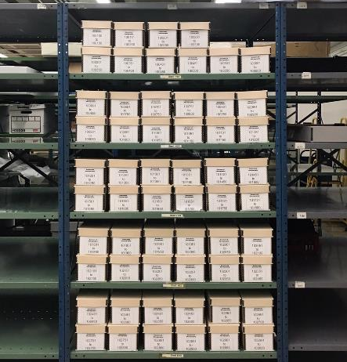
PROJECT Background
Homewood Photography
Campus photographers
Does contract work for on-/off-campus clients
Administratively part of Arts & Sciences
Prior holdings
Analog work (prints, negatives, slides, etc.) already in our custody
Fully digital workflow
Since 2004
Accrual rate of 2-3 TB/year
Stored on DVDs

Slide 4
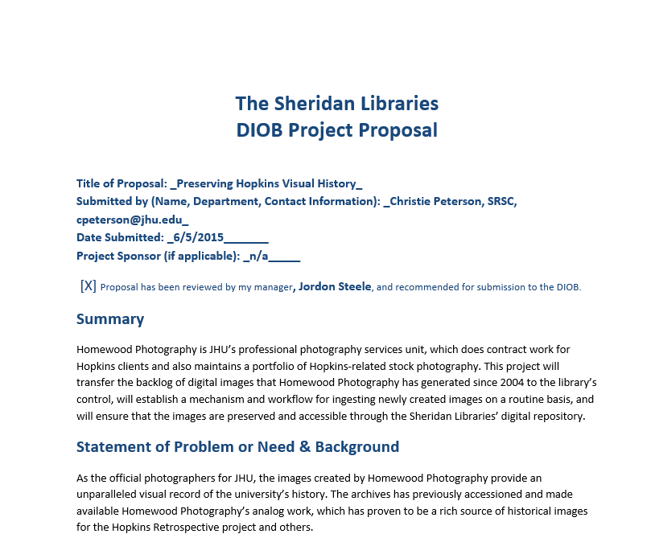
PROJECT Background

Slide 5
PROJECT Background
Rejected

Slide 6
Solutions with dividends
Resource implications
Staff: LC funded, 1 extra “free” FTE professional
Infrastructure: Needs to be answered soon anyway!
Timing
Dictated by terms of residency
Kismet: Mikulski, data archivist, etc.
Project Plan
Charter completed October 2016
Ripples across departments
Team created to support the project; all sign project charter
Digital Preservation team
Born-digital program maturity

Slide 7
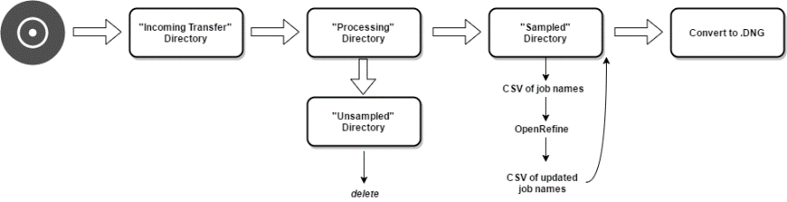
workflow

Slide 8
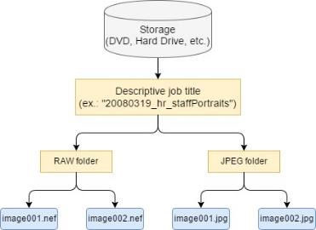
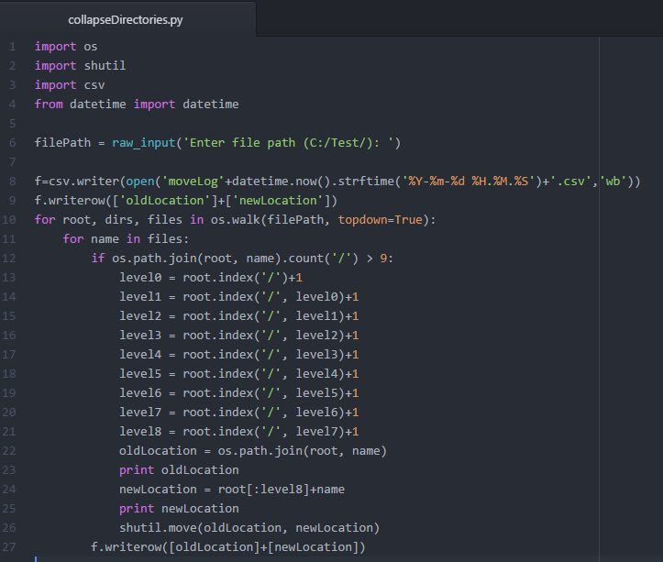
AUTOMATION
Collapse directory structures – collapseDirectories.py

Slide 9
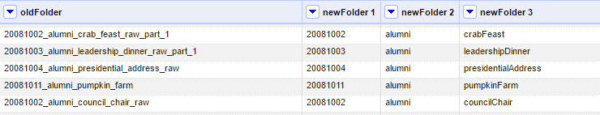
DESCRIPTION CLEAN-UP
Export folder names as CSV
Clean up in OpenRefine
Change folder names – renameDirectories.py

Slide 10
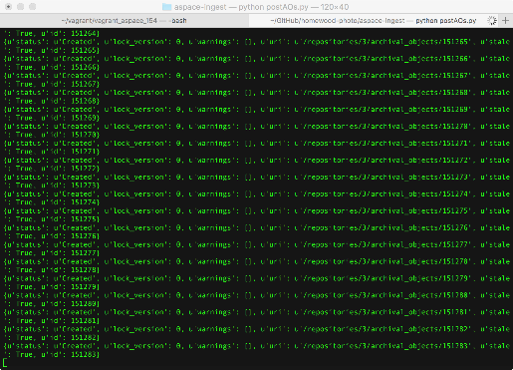
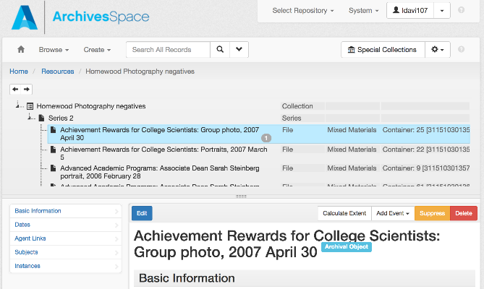
DESCRIPTION in ASpace
https://github.com/jhu-archives-and-manuscripts/homewood-photo/tree/master/aspace-ingest

Slide 11
PERCEPTUAL HASHING
Residency has added increased room for exploration
Minimal viable product:
Recursively compare the visual content of directory of images in a many-to-many scenario and identify groupings of potentially like images;
Complete transparency as to how content grouping was achieved for each batch of images processed and allow for adjustments in sensitivity (e.g. a digital preservation friendly configuration file identifying threshold values used that can be packaged with archival information packages (AIPS));
Allow tool to run locally given both the sheer size of and potential restricted content in the type of born-digital image collections archives routinely acquire.
https://docs.google.com/document/d/1ee5J6ahatOOvX88ZCrm5dWWeV57ArNyowIWL77Hf5Ho/edit?usp=sharing

Slide 12
PROJECT DOCUMENTATION
https://github.com/jhu-archives-and-manuscripts/homewood-photo

